Slide 1

EV Charging Session Peak Classification
2025
Name : Penaganti Sai
Section : K22UP
Roll no : 30
Reg no : 12219418
Addressing Congestion and Power Grid Challenges in Electric Vehicle Adoption

Slide 2
Introduction
The rapid adoption of electric vehicles represents a critical transition in our transportation ecosystem, with global EV sales growing at an unprecedented rate. While this shift promises significant environmental benefits and reduced dependency on fossil fuels, it brings forth new challenges:
The exponential growth of the EV market is outpacing the development of sufficient charging infrastructure
Charging stations in urban centers and along major highways increasingly face congestion during peak travel times
Local power grids are experiencing strain as multiple high-power charging sessions coincide
The unpredictable nature of charging demand creates inefficiencies for both users and utility providers

Slide 3

01
Challenges

Slide 4
EV Charging Congestion
The rapid increase in electric vehicle usage has led to significant congestion at charging stations. This congestion results in longer wait times for EV users, which can discourage potential adopters. Addressing this issue requires innovative strategies to manage charging times and location effectively.
Impact of Charging Congestion
Peak-hour bottlenecks at popular stations can result in wait times exceeding 30-45 minutes
EV drivers report developing "charging anxiety" - fear of not finding available chargers when needed
Workplace charging facilities face particular pressure during morning arrival times
Popular travel corridors experience severe congestion during holiday and weekend peak periods
Fast-charging infrastructure is disproportionately affected due to higher demand and shorter session times

Slide 5

Grid Strain during Peak Hours
High demand for electricity during peak hours creates strain on the power grid, resulting in increased electricity costs and potential outages. Power grid operators must find ways to balance demand with supply, particularly as more electric vehicles are charged simultaneously during these peak times
Infrastructure Vulnerability
Existing grid infrastructure in many regions was not designed to accommodate the concentrated power demands of multiple high-capacity EV chargers (50-350 kW) operating simultaneously
Transformers and local distribution equipment can experience accelerated aging and failure when repeatedly exposed to demand spikes from EV fast charging

Slide 6
Inefficient Energy Distribution
Inefficient distribution of energy exacerbates the challenges faced by power grid operators. When demand surges, the existing infrastructure may struggle to allocate resources effectively, resulting in energy waste, increased costs, and a greater environmental impact. Implementing more efficient distribution strategies is crucial to align supply with the growing demand from electric vehicles.
System-Wide Inefficiencies
Voltage fluctuations from uncoordinated charging can increase line losses and reduce overall grid efficiency
Power quality issues including harmonic distortion from multiple chargers can affect sensitive equipment and increase maintenance requirements

Slide 7
02
Machine Learning Model

Slide 8

Data Collection and Analysis
To develop a robust machine learning model, comprehensive data collection and analysis are essential. Historical charging data, including timestamps, locations, and energy usage patterns, will be gathered to understand user behavior. This data will be analyzed to identify trends and factors influencing peak demand, providing a solid foundation for the predictive model.

Slide 9
Peak vs Off-Peak Classification
The core functionality of the machine learning model involves classifying EV charging sessions into peak or off-peak categories. Using algorithms trained on historical data, the model will analyze real-time charging patterns to predict demand accurately. This classification will help charging station providers optimize their operations and implement dynamic pricing strategies.

Slide 10
Random Forest Classifier
I selected the Random Forest Classifier as my primary model for classifying EV charging sessions into peak and off-peak periods. This decision was driven by several key strengths of the Random Forest algorithm:
High Accuracy with Minimal Tuning:
Random Forest is known for delivering strong predictive performance right out of the box. It aggregates predictions from multiple decision trees, reducing the risk of overfitting while maintaining high accuracy, making it ideal for our classification task.
Handles Both Numerical and Categorical Data:
My dataset includes a mix of feature types (e.g., charging rate, vehicle model, start time). Random Forest handles these without requiring intensive preprocessing or one-hot encoding of categorical variables.

Slide 11
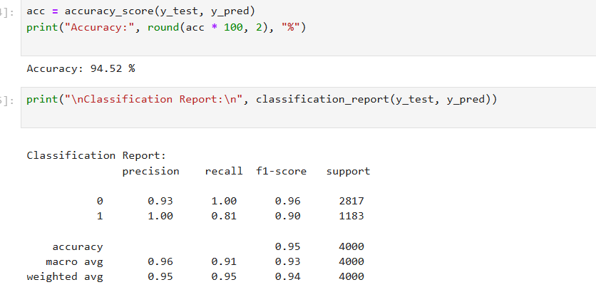
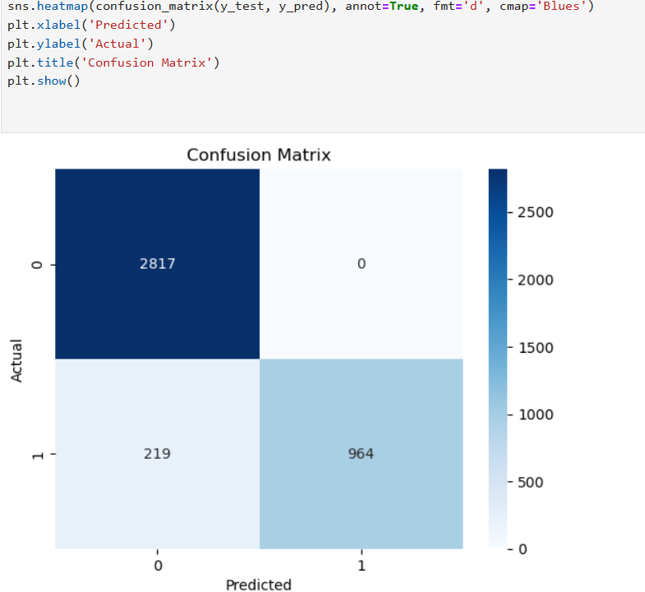
RESULTS

Slide 12
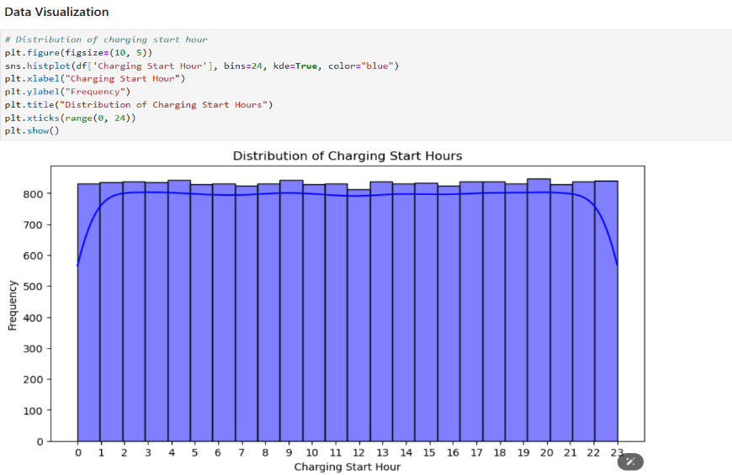
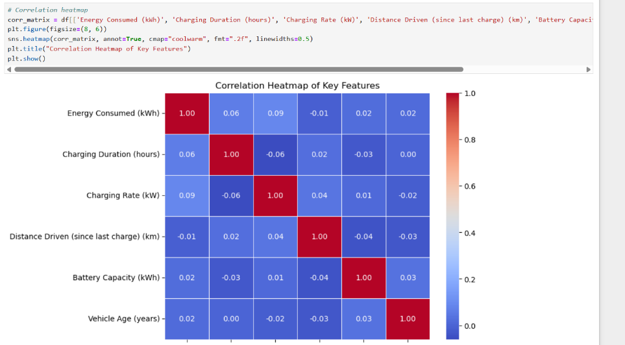
RESULTS

Slide 13
Conclusion
As electric vehicle adoption continues to rise, addressing the challenges of charging station congestion and power grid strain is imperative. By leveraging machine learning to predict demand accurately, stakeholders can implement more efficient energy distribution strategies, optimize charging infrastructure, and enhance the overall user experience. This proactive approach not only benefits individual users but also supports a sustainable energy future.

